Slide 1

CampusBites: A Cloud-Based Canteen Pre-Order System
Course: BS Software Engineering | Instructor: Dr. Zunnurain Hussain | Teaching Assistant: Umair Makhdoom
Group Members: Muhammad Samer Nisar(23113), Ahmad Umer Khan(23008), Mirza Muhammad Rehan(23021)

Slide 2


Addressing Canteen Inefficiencies with Innovation
CampusBites is an innovative web-based canteen pre-ordering system designed to modernize food services on university campuses. It leverages cutting-edge cloud-native technologies to ensure unmatched reliability and scalability.
Problem: Traditional manual ordering leads to long queues and stress.
Solution: CampusBites allows students to place food orders online before reaching the canteen.
This system aims to significantly improve the overall student experience, especially during short academic breaks.

Slide 3
The Challenges of Manual Canteen Systems
University canteens typically operate on a manual first-come-first-served basis, which creates significant bottlenecks and inefficiencies.
Congestion & Wasted Time
Staff Stress
Short academic breaks (15-30 minutes) result in long queues and wasted student time.
High demand during peak hours places immense stress on canteen staff, affecting service quality.
Human Errors & Delays
Inefficiency & Scalability
Manual order handling is prone to errors, leading to slow service and customer dissatisfaction.
The existing system is inefficient and cannot scale to meet demand during peak hours.
These issues collectively diminish the student experience and hinder operational flow.

Slide 4






Key Objectives for a Modern Canteen System
Our primary goal is to transform the canteen experience by implementing a system that is secure, efficient, and user-friendly.
Secure & Scalable Design
Develop a robust canteen pre-order system that is both secure and scalable.
Reduce Queues & Waiting Times
Minimize physical queues and student waiting times through online pre-ordering.
Real-Time Updates
Provide students with real-time updates on their order status from placement to pickup.
User Accountability
Ensure accountability and prevent fake orders through user authentication.
Cloud Deployment
Deploy the entire system using a cloud-based architecture for optimal performance.
High Availability
Guarantee high availability during peak usage to prevent service disruptions.

Slide 5
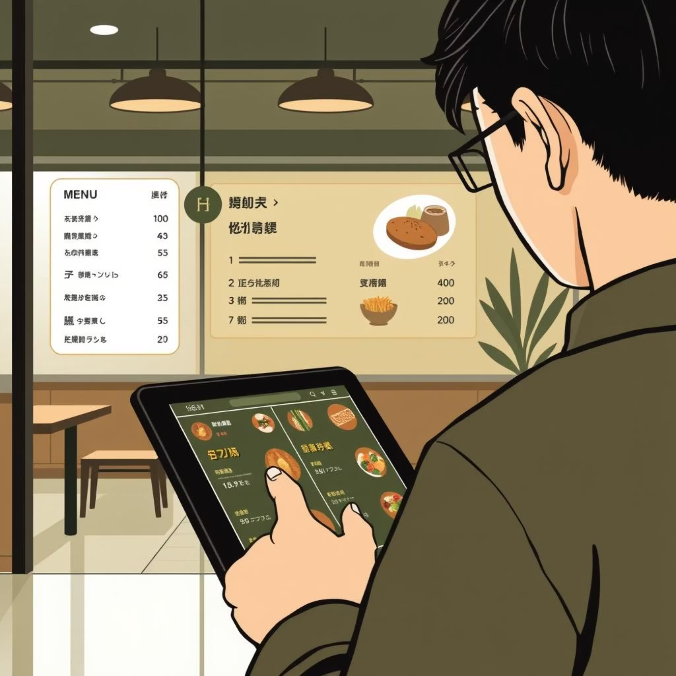
CampusBites: A Cloud-Hosted Web Application
Our proposed solution is a sophisticated cloud-hosted web application that streamlines the food ordering process for university canteens.
Secure Access: Students log in using verified university credentials.
Seamless Ordering: Users can easily browse the menu and place orders online.
Kitchen Integration: Orders are immediately sent to a kitchen staff dashboard for preparation.
Live Tracking: The system provides real-time updates on order status.
The system is built on a robust 3-tier cloud architecture utilizing AWS services, ensuring efficiency and reliability.

Slide 6




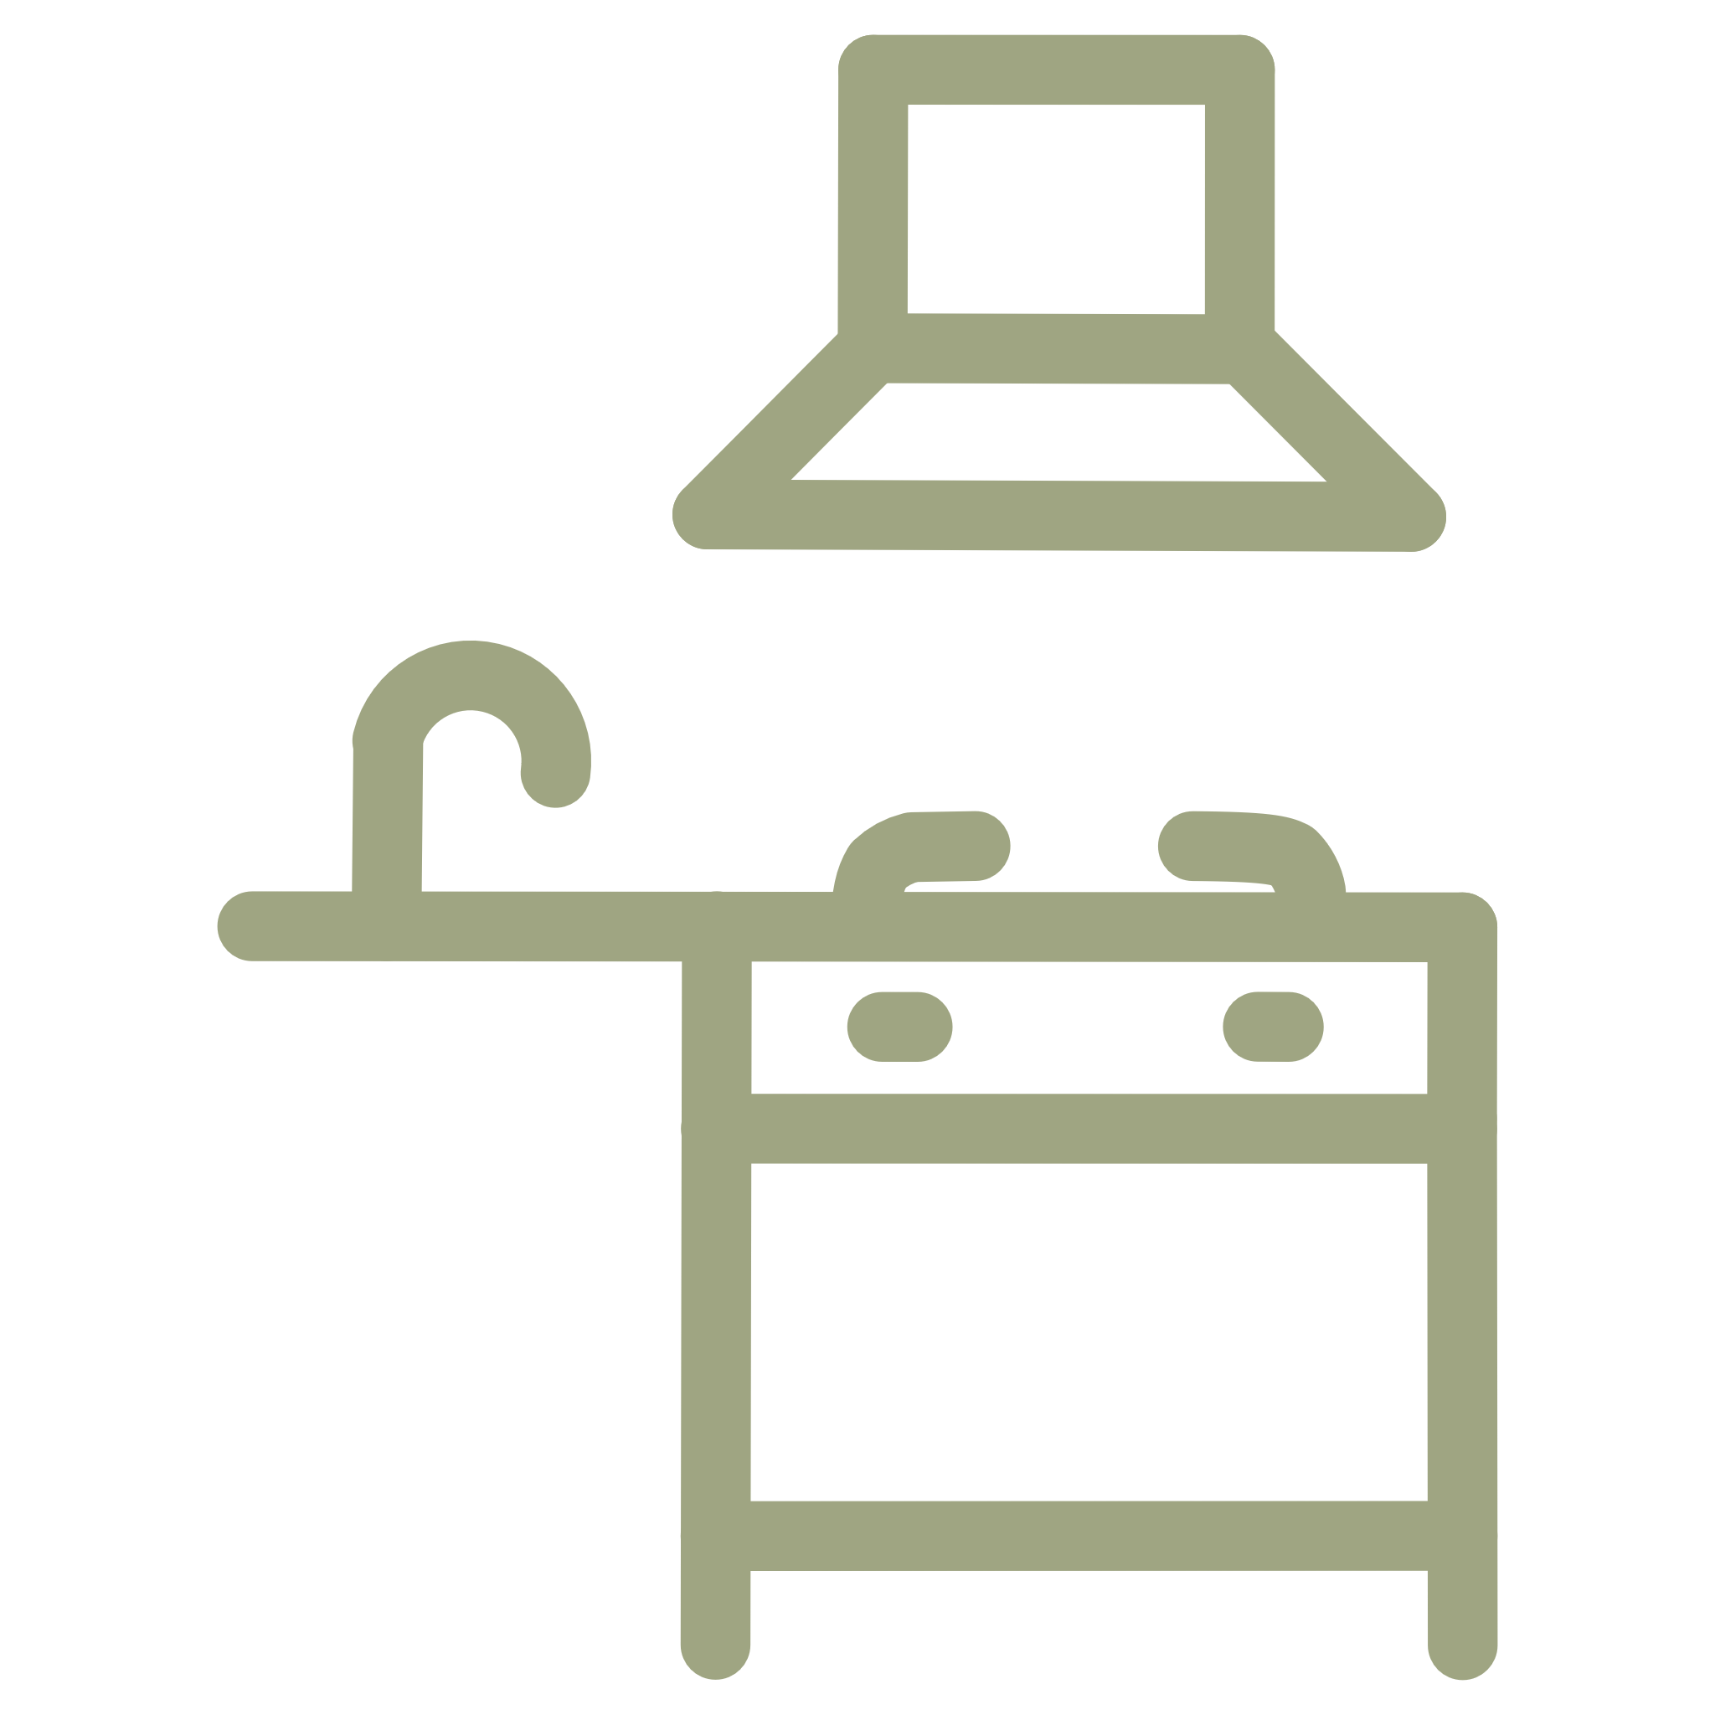


Core Features of CampusBites
CampusBites is packed with features designed to enhance both the student and staff experience, making canteen operations smoother and more efficient.
Secure User Authentication
Real-Time Menu Display
Online Pre-Ordering System
Validated student and staff ID login for secure access.
Up-to-date menu availability, prices, and specials.
Convenient food ordering from anywhere on campus.
Live Order Status Tracking
Kitchen Staff Dashboard
Automatic Scaling
Students can monitor their order progress in real-time.
Efficient order management and preparation for staff.
System automatically adjusts to handle peak hour demand.
Secure Data Storage
Robust management and protection of all user and order data.

Slide 7
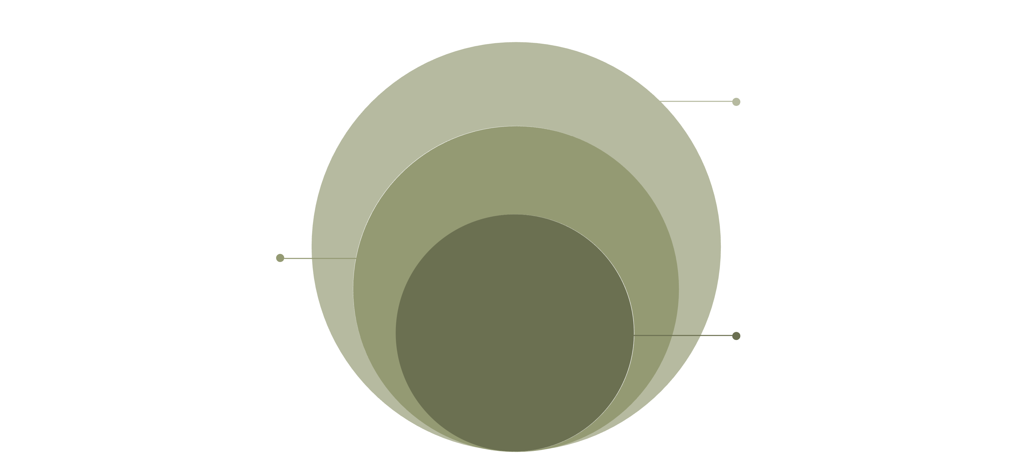
Robust 3-Tier Cloud Architecture
CampusBites employs a standard, highly effective 3-tier architecture deployed on Amazon Web Services (AWS) to ensure scalability and reliability.
Data Layer
PostgreSQL persistent storage on AWS
Application Layer
Node.js API handling business logic
Presentation Layer
React.js frontend for user interaction
Presentation Layer (Frontend): Built with React.js, this is the user-facing web interface for order placement and interaction.
Application Layer (Backend): Powered by a Node.js API, it manages business logic, order processing, and communication between frontend and database.
Data Layer (Database): A PostgreSQL database stores all critical data, including user profiles, menu items, and order details.

Slide 8
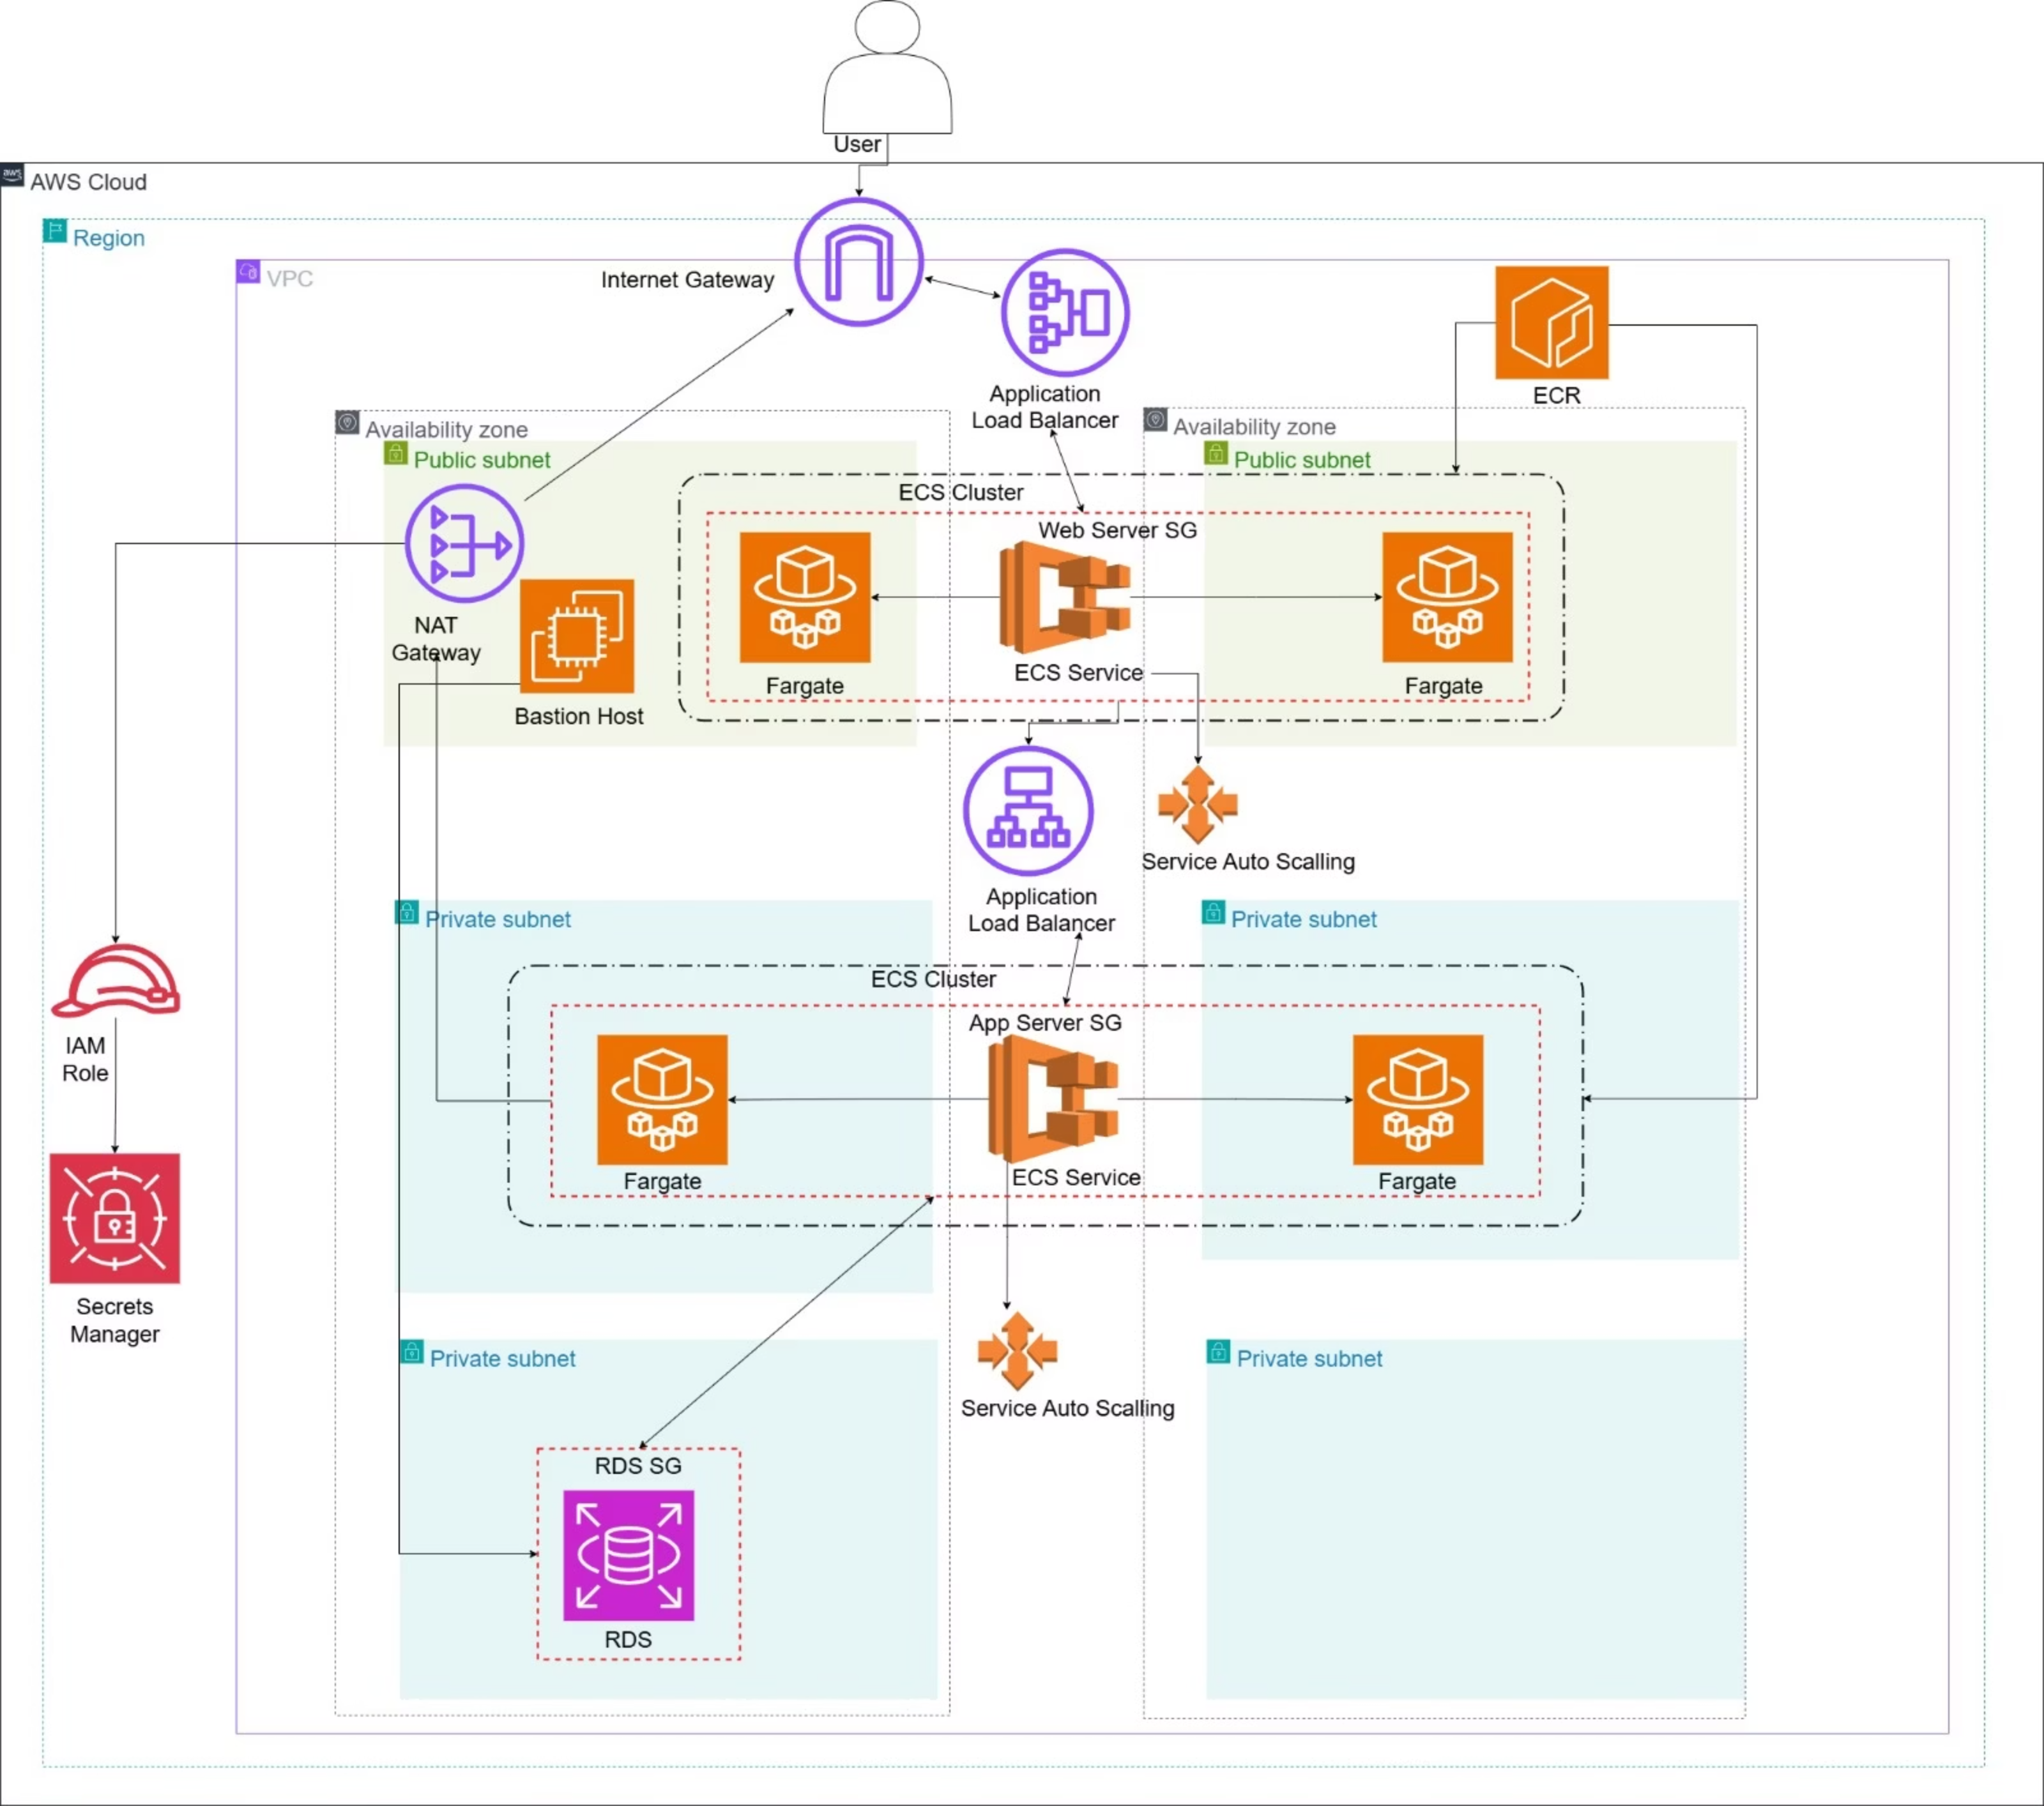
Detailed AWS Infrastructure Architecture
CampusBites leverages AWS services including EC2, ECS, RDS, Load Balancers, and Auto Scaling Groups to create a highly available, fault-tolerant system that automatically handles traffic spikes and ensures optimal performance during peak usage times.

Slide 9

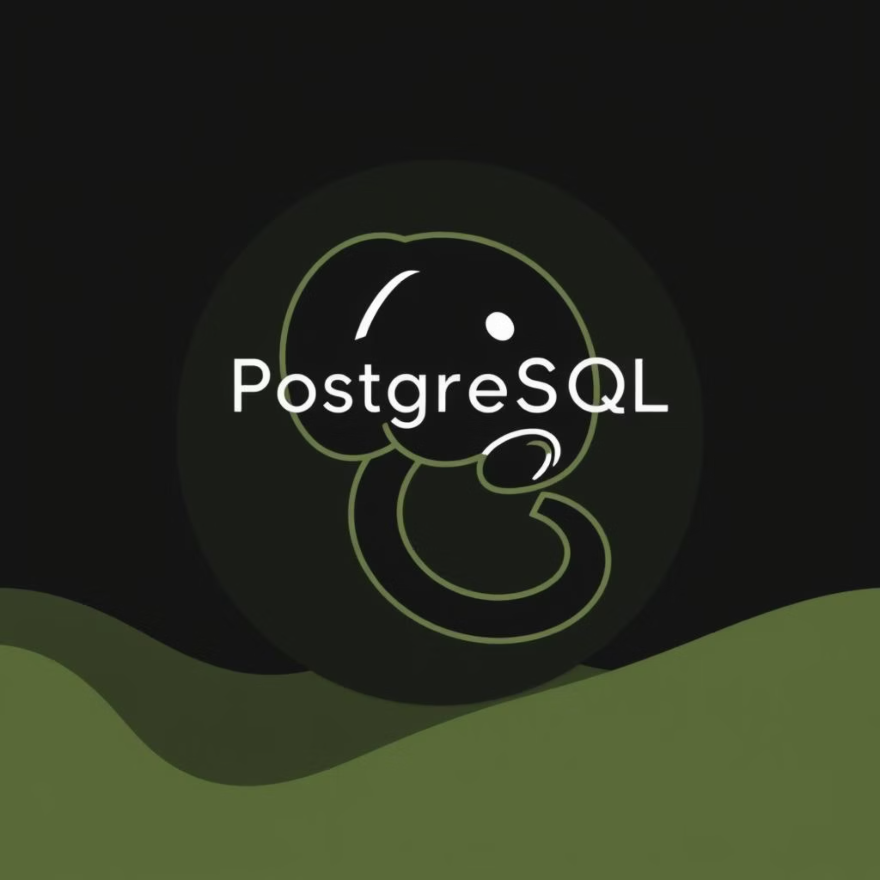

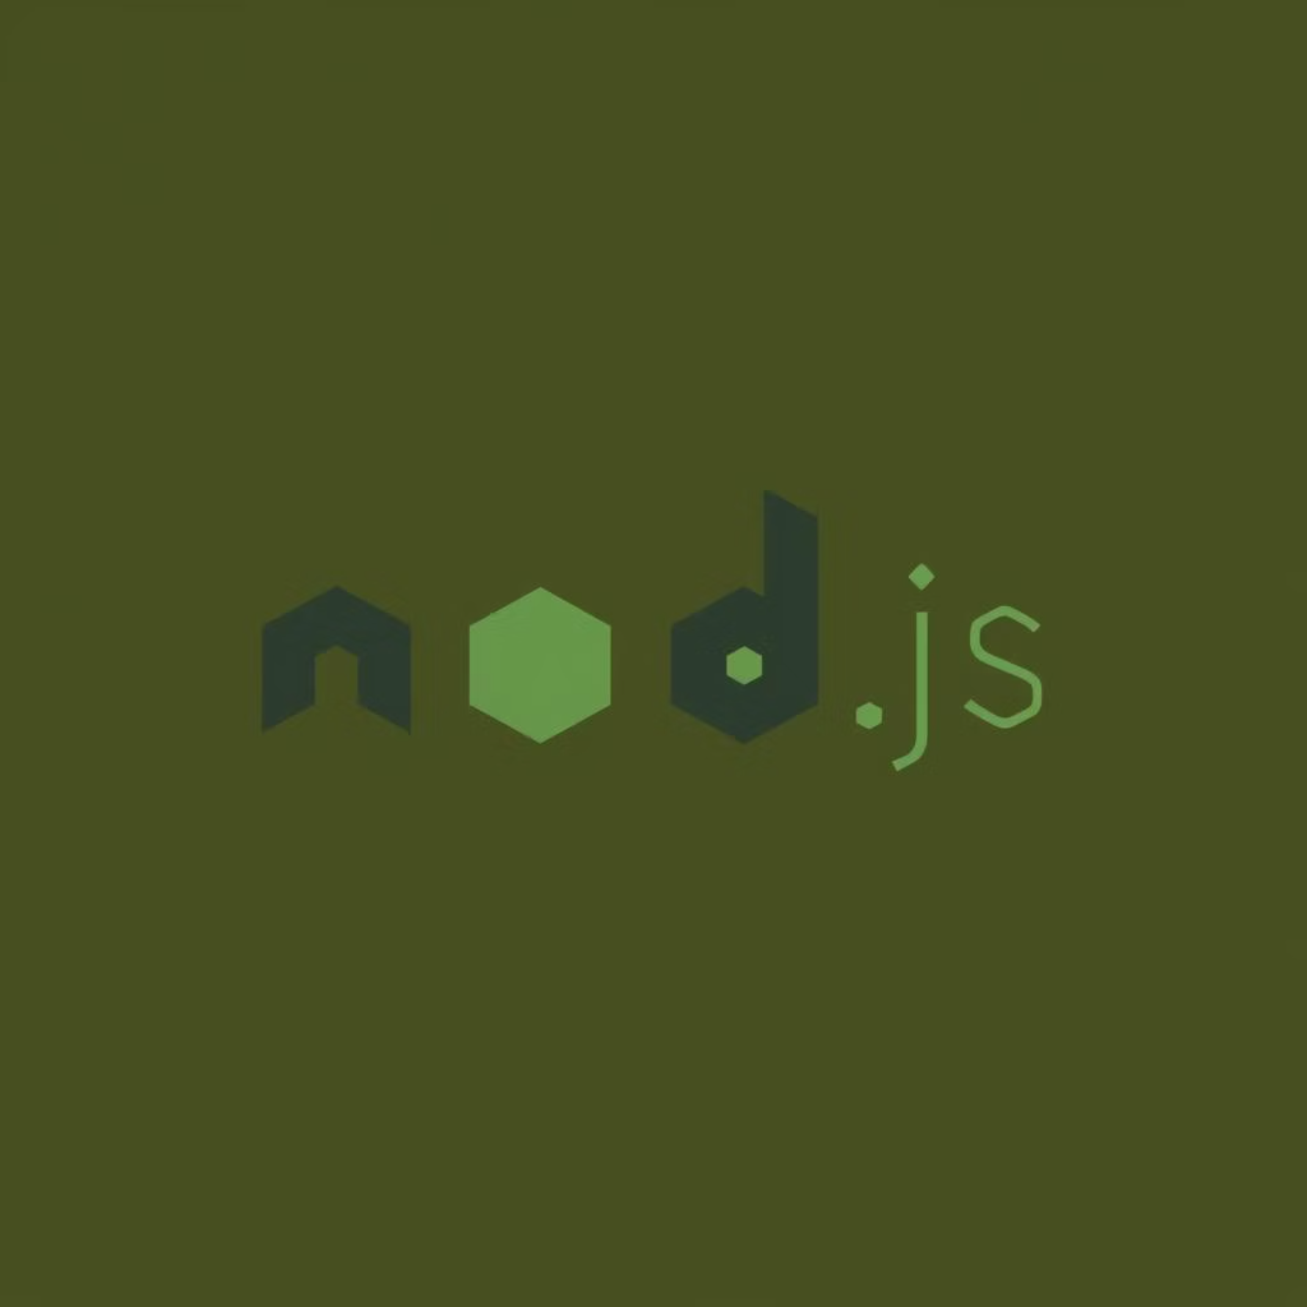
Cutting-Edge Technology Stack
CampusBites is built using a modern technology stack, ensuring high performance, security, and maintainability.
Frontend
Database
React.js for dynamic and responsive user interfaces.
PostgreSQL, hosted on Amazon RDS for managed database services.
Standard web technologies: HTML, CSS, JavaScript.
Cloud Platform
Backend
Amazon Web Services (AWS) for robust cloud infrastructure.
Node.js for server-side logic and fast API responses.
ECS with Fargate for container orchestration without server management.
RESTful APIs for seamless data exchange.
Application Load Balancer (ALB) for efficient traffic distribution.

Slide 10

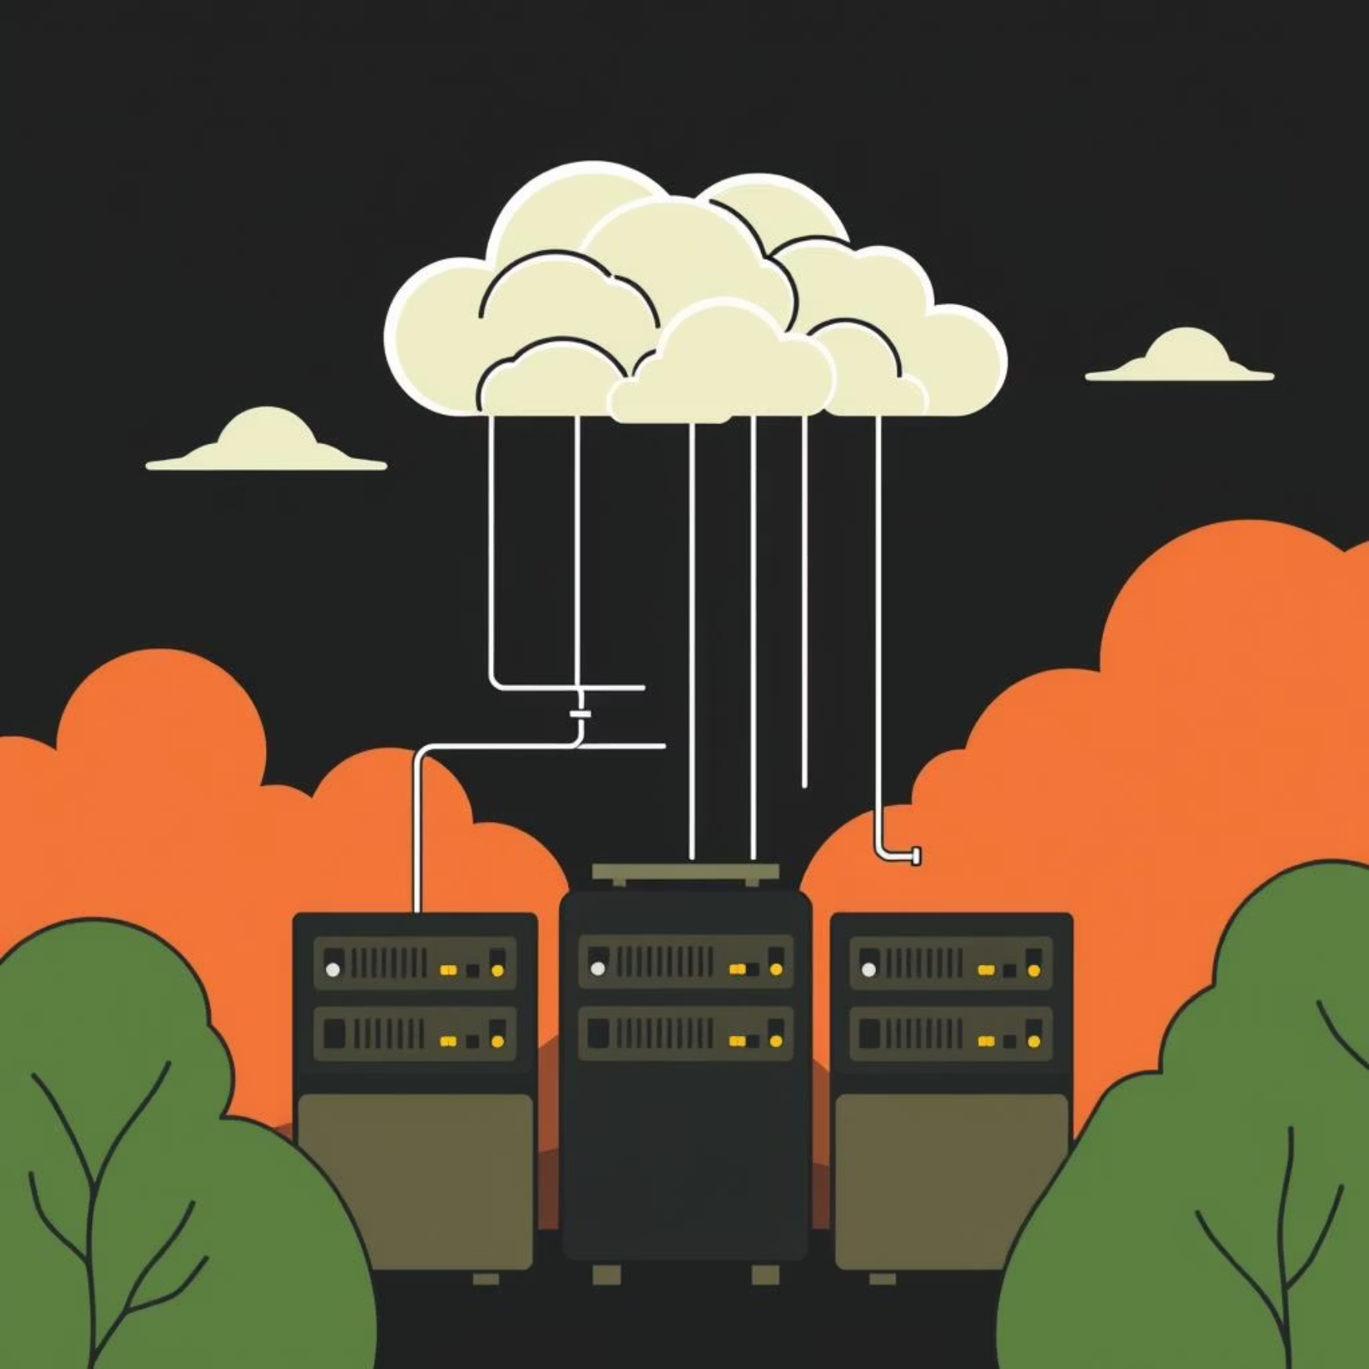
Security and Scalability at Core
CampusBites is designed with a defense-in-depth security approach and robust scalability features to ensure continuous, reliable service.
Security Design
Scalability & Availability
Private Subnets: Application and database deployed in isolated private networks.
Multi-AZ Deployment: Ensuring high availability and disaster recovery.
IAM Roles: Enforcing least-privilege access for all components.
ECS Service Auto Scaling: Dynamically adjusts resources based on CPU usage.
AWS Secrets Manager: Securely storing sensitive credentials.
Load Balancers: Efficiently distributing incoming traffic to maintain performance.
Security Groups: Granular network access control, preferred over IP-based rules.
Fault Tolerance: System automatically handles traffic spikes during peak times.
Bastion Host: Secure administrative access to the database.

Slide 11





Expected Outcomes & Conclusion
CampusBites promises to revolutionize university canteen operations, delivering a significant positive impact on both students and staff.
Reduced Waiting Time
Elimination of physical queues, enhancing student satisfaction.
Faster Order Processing
Efficient workflow for canteen staff and quicker service.
Improved Accountability
Minimizes fake orders and enhances operational integrity.
Scalable Future-Proof System
Ready for future expansion and evolving campus needs.
CampusBites successfully demonstrates the practical application of cloud computing to solve real-world problems, making it an ideal solution for modern university environments.
Thank You. Questions?

